Slide 1
Python and the Web
Unit 4- Chapter 2

Slide 2
Screen Scraping
Screen scraping is the process of collecting screen display data from one application and translating it so that another application can display it. This is normally done to capture data from a legacy application in order to display it using a more modern user interface.
Screen scraping usually refers to a legitimate technique used to translate screen data from one application to another.
Screen scraping is the act of copying information that shows on a digital display so it can be used for another purpose. Visual data can be collected as raw text from on-screen elements such as a text or images that appear on the desktop, in an application or on a website. Screen scraping can be performed automatically with a scraping program or manually with an individual extracting data.
Screen scraping has a variety of uses, both ethical and unethical.
A developer might be tempted to steal code from another application to make the process of development faster and easier for themselves.

Slide 3
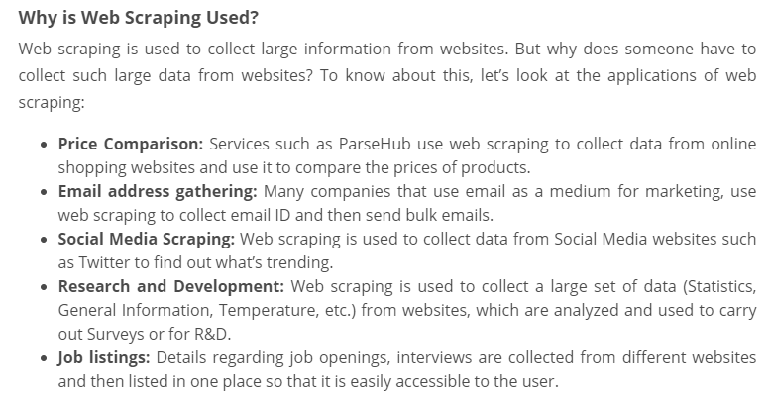
Web Scraping
Imagine you have to pull a large amount of data from websites and you want to do it as quickly as possible. How would you do it without manually going to each website and getting the data? Well, “Web Scraping” is the answer. Web Scraping just makes this job easier and faster.

Slide 4
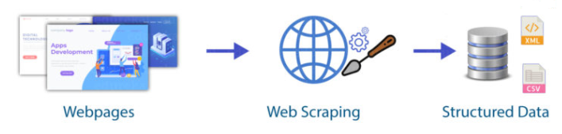
What is Web Scraping?
Web scraping is an automated method used to extract large amounts of data from websites. The data on the websites are unstructured. Web scraping helps collect these unstructured data and store it in a structured form. There are different ways to scrape websites such as online Services, APIs or writing your own code.

Slide 5
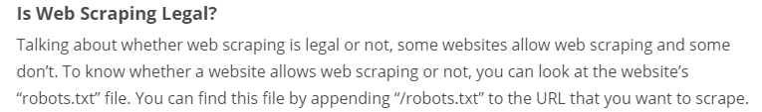
Packages and Methods used for implementing Web scraping in Python. Refer below links.
Scraping Javascript site
https://medium.com/technofunnel/web-scraping-with-python-using-beautifulsoup-76b710e3e92f
Scaping FIFA site
https://towardsdatascience.com/web-scraping-5649074f3ead

